Slide 1


Cricket Score Checker App
SCORZZ

Slide 2
Team Members
Avinash Tiwari
Aman Kumar Singh
Prince Kumar Sharma

Slide 3
Abstract
Introduction
Content
Project Analysis
Project Progress Evaluation
Alternative Solution Analysis
Future Scope

Slide 4


Abstract
Scorzz in an android application that allows user to check the scores of cricket matches matches happening around the globe.
This application is established for all the cricket lovers who are looking for a fully
dedicated application for purpose of checking cricket scores only.

Slide 5

Introduction
‘SCORZZ’ is an android app that can be used over a stable Internet Connection. This app is basically used for checking the detailed scores of a cricket match.
The main aim of this project is to make this application suitable for people of all ages, even a small kid too. Unlike most of the sports application these days, SCORZZ doesn’t contain fantasy games and betting(which has its disadvantages).

Slide 6
Project Analysis
Objective:
Easy, Secure and simple android application to check cricket scores.
Problem:
Most of the score checking application contains fantasy cricket and betting thus making themselves severe for use by a minor.
Solution:
Work on an application that is free from betting and is suitable for people of every age group.

Slide 7
PROPOSED SOLUTION
The solution to this problem is to develop an application fully dedicated to check scorecard only.
Users can access the application through their android devices with the help of a stable Internet connection from anywhere, at anytime.

Slide 8
OBJECTIVES
The main objectives of the Scorzz include:
To provide Users with the list of all the matches happening, happened or will happen in recent past.
To enable the user to check the match summary and player list.
To enable the user to check the detailed batting and bowling card of both the innings of the game.
To reduce the risks that many sports application possess for minor age.

Slide 9



Analyzing the cost of the solution
Cost : No Cost the project is hosted on Android Studio.
Time to Develop : 30 hours
Time to Deploy : 5minutes

Slide 10
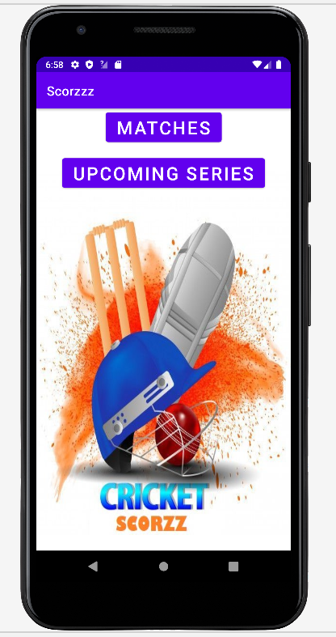
Home Page:

Slide 11
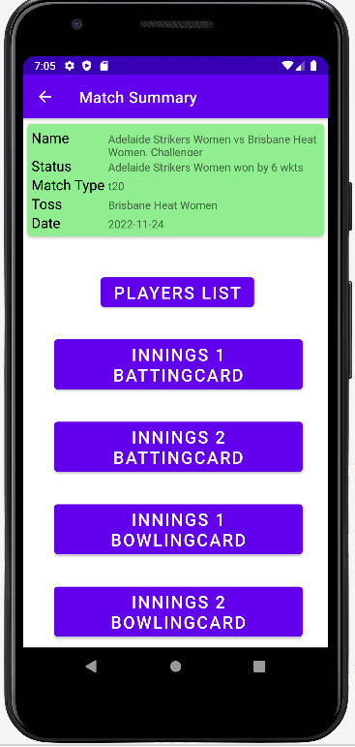
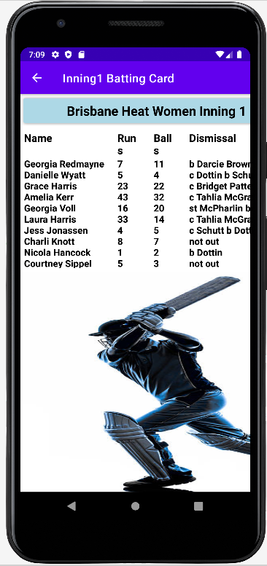
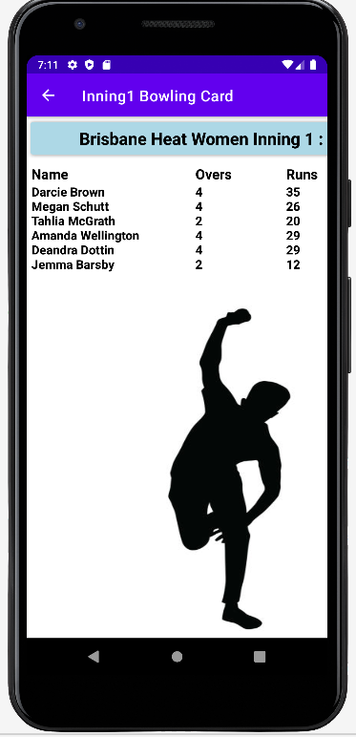

Slide 12
Technologies Used for development
Java: Java is a programming language and a platform. Java is a high level, robust, object-oriented and secure programming language.
Xml: Xml (extensible Markup Language) is a mark up language. XML is designed to carry data, not to display data.
JSON: JSON stands for JavaScript Object Notation. JSON is a text format for storing and transporting data. JSON is "self-describing" and easy to understand

Slide 13
Future Plans
I would like to say that my application do not capture everything that would be required and would therefore recommend for future improvement on the following:
A features to allow the users to read sports news.
Features to enable clients give their feedback and suggestions.
Integrating the system with Apple pay for customers to make payments using the system.
Implementation tracking system for the clients to track the bus.

Slide 14
Conclusion
It can be observed that android applications are very important in every field of human endeavour. Here all the information about cricket that occurred or going to occur can be gotten just by clicking system are overcome.
The user can access any live score of any cricket match happening at a competitive level.

Slide 15
Thank You

